Slide 1

EduCoach AI
Adaptive AI-Powered Placement Preparation Platform with Multi- Agent Intelligence and Personalized Career Readiness
Satya Sri R | B.Tech CSE (AI & ML)
Project Guide: Dr. G. Sangeetha
Final Year Project | Academic Year 2026 - 2027
Notes:
Good morning. This is my final year project, EduCoach AI. It is a web platform that helps students prepare for campus placements, and it adjusts the practice to each student.

Slide 2
Abstract
Placement preparation is still done with separate tools. Students practise coding on one website, aptitude on another and technical subjects from notes, and a mock test gives them a score without saying what to revise. These tools do not share any information about the learner, so practice is not matched to the learner's level and the overall readiness is never visible. This project proposes EduCoach AI, an adaptive placement-preparation platform that brings Technical, Verbal, Aptitude and coding practice into one web application with one learner profile. The platform holds 380 validated questions in 135 topics, of which 179 aptitude questions are generated automatically with correct answers and worked explanations. Every practice test has exactly 30 distinct questions under a countdown timer. An Elo-style ability rating is kept for every learner and topic and decides which questions are shown next. Every answer is stored, so accuracy, weak topics and strong topics are measured per question. After each test the student gets an answer review with explanations, and a mistake notebook, an AI Mentor with a seven-day plan and a Random Forest readiness prediction (Low, Medium or High) guide the next practice. Python coding problems are judged against hidden test cases. The application is protected with salted password hashing, CSRF tokens and login throttling, and an admin panel imports questions from CSV files. The platform is built with Flask, SQLite and scikit-learn. A suite of 24 automated tests passes, every topic gives a full 30-question test, the readiness model reaches 69.5% hold-out accuracy and 71.5% cross-validation accuracy, and the main pages respond in a few milliseconds. The model is trained on a simulated cohort because no real placement data was available, and this is stated openly in the application and in the report. The code judge is not a full sandbox and judges Python only. No study with real students has yet been carried out. Existing work usually treats adaptive rating, feedback and readiness prediction separately, and practice tools are usually built around one skill. The proposed system differs by carrying practice, adaptation, feedback and readiness estimation under a single learner profile that a college can host on an ordinary laptop.
Notes:
The main idea: one place for all four skill areas, and it remembers what the student knows. I will explain each part in the next slides.

Slide 3
Problem statement
1
Practice is spread over many tools
Coding on one site, aptitude on another, technical subjects from notes.
In one line
Students need one place that practises all four skills, adjusts to their level and tells them what to do next.
2
Same fixed test for everyone
A strong student is bored, a weak student gets discouraged.
3
Only a score, no feedback
The student does not know which topic or which questions to revise.
4
No single view of readiness
Nothing says how ready the student is for the placement round.
Notes:
We found these four problems from how students around us actually prepare. The last box is the problem statement in one sentence.

Slide 4
Objectives
Build a question bank where every question is different and has an explanation
Generate aptitude questions automatically with the working shown
1
2
Give every test 30 distinct questions chosen by a per-topic Elo rating
Show an answer review, a mistake notebook and a 7-day study plan
3
4
Predict readiness (Low, Medium, High) with a Random Forest and report it honestly
Judge Python code with hidden test cases and keep the application secure
5
6
Notes:
These six objectives became the six main parts of the project. The results slides check each of them.

Slide 5
Literature review (1 of 2)
Paper | What they did | Limitation / what we added
Pelánek, 2016 (base paper) Elo rating in adaptive educational systems | Shows how Elo rating can estimate learner skill and question difficulty, updating after every answer. | A review of the method only. No full practice platform. We use it inside one.
Corbett and Anderson, 1994 Knowledge tracing | Estimates the chance that a learner knows a skill, in a programming tutor. | Skills and parameters must be set first. We use a simpler rating.
Piech et al., 2015 Deep knowledge tracing | A neural network predicts the next answer from the earlier answers. | Needs a lot of real student data, which we do not have.
Breiman, 2001 Random forests | Many decision trees vote on the answer. It also shows feature importance. | A general method. We train it to give a readiness label.
Notes:
The first paper is our base paper. It explains the Elo rating idea that we use to choose question difficulty. The other three give us the tracing idea and the Random Forest.

Slide 6
Literature review (2 of 2)
Paper | What they did | Limitation / what we added
Roediger and Karpicke, 2006 Test-enhanced learning | Taking tests helps long-term memory more than reading the notes again. | A study, no software. It is the reason we use frequent timed tests.
Hattie and Timperley, 2007 The power of feedback | Feedback works best when it tells the learner what to do next. | No tool built. We add answer review, notebook and study plan.
Typical practice websites (our own observation) | Large question lists and online judges for coding. | Usually one skill, fixed tests, no rating for each topic.
Research gap
The papers explain methods, but none gives a complete practice platform that covers aptitude, verbal, technical and coding, adapts per topic, gives feedback and estimates readiness.
Notes:
The last two rows are education studies that support the idea of tests and feedback. The gap is that nobody joined everything into one platform that a college can run.

Slide 7
Proposed system
Every student has one profile. Each step reads from it and writes back to it.
1
2
3
4
5
Practice
Rate
Analyse
Predict
Advise
Student picks a topic. The system gives 30 distinct questions near their rating.
Every answer updates the Elo rating of that topic.
Accuracy is counted per topic. Below 60% is called weak.
After 3 tests a Random Forest gives Low, Medium or High readiness.
Review, mistake notebook and a 7-day plan show what to do next.
The coding module (13 problems, judged on hidden test cases) sits beside this loop.
Notes:
This loop is the heart of the project: practise, rate, analyse, predict, advise, and then practise again with better questions.

Slide 8
System architecture
Presentation
Dashboard
Test page
Result review
Analytics
AI Mentor
Admin
HTML, CSS, Chart.js
Application
Login + CSRF
Test engine
Elo update
Analytics
CSV import
Flask (Python)
Intelligence
Question generators
Readiness model
Mentor rules
Python judge
Python, scikit-learn
Data
users
questions
attempts
answers
ability
code submissions
SQLite
Notes:
We kept four layers. The pages talk only to Flask, Flask talks to the logic and the database. Because of this, the rating code and the question selector can be tested without opening a browser.

Slide 9
Flow diagram
Student (browser)
login, answers
Flask routes
topic, mode
Test engine
questions
SQLite database
scores
code
verdict
Python judge
saved answers
Mentor, dashboard, review pages
Analytics, Elo, Random Forest
pages shown to the student
weak topics, readiness
Notes:
Follow the arrows. The student sends a request, Flask builds a test, the answers go back and are saved in SQLite, the analytics read them, and the next pages show the result and advice. The code judge is a side branch for the coding problems.

Slide 10
Flowchart
No, try again
Valid user?
Start
Login / register
Yes
Pick category, topic and mode
Score and save every answer
Submit, or time is up
Timer starts, student answers
Select 30 distinct questions
3 or more tests?
Update Elo ratings
Yes
Predict readiness
Show review and advice
End
No, skip the prediction
Notes:
This is the path of one test, from login to the result page. There are only two decisions: whether the login is valid, and whether the student has taken at least three tests, because the readiness model needs some history.

Slide 11
Modules
1
Authentication
2
Question bank
3
Test engine
4
Adaptive engine
Login, hashed passwords, CSRF
380 questions and generators
30 distinct questions, timer
Elo rating for each topic
5
Analytics
6
Readiness model
7
AI Mentor
8
Mistake notebook
Accuracy and weak topics
Random Forest prediction
Advice and 7-day plan
Wrong answers with reasons
9
Coding judge
10
Admin panel
11
Database
12
Web interface
Python, hidden test cases
Statistics and CSV import
SQLite with 6 tables
Pages, charts, phone friendly
Notes:
There are twelve modules. The first six form the learning loop, the rest support it. Each one is a separate Python function or file, so we could test them one by one.

Slide 12
Software and hardware requirements
Software
Language | Python 3.11 or newer
Web framework | Flask 3
Database | SQLite 3
Machine learning | scikit-learn, NumPy
Charts | Chart.js
Tools | VS Code, Git
Operating system | Windows 10/11 or Linux
Hardware
Computer | Laptop or PC, dual-core CPU
Memory | 4 GB (8 GB better)
Storage | 200 MB free
GPU | Not needed
Student device | Any device with a browser
Network | Localhost or college LAN
Notes:
Nothing here is heavy. The Random Forest trains in about two seconds, so no GPU is needed, and SQLite is a single file so it installs with nothing.

Slide 13
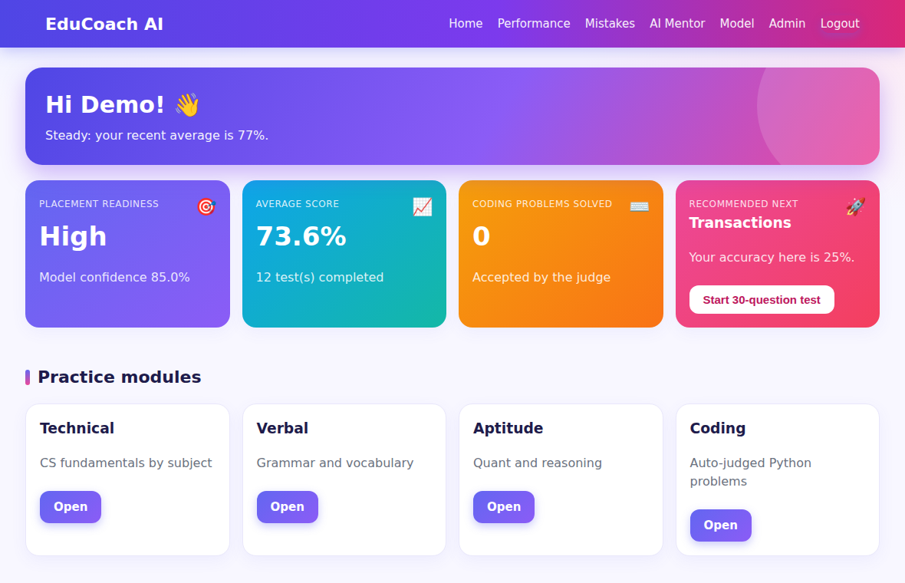
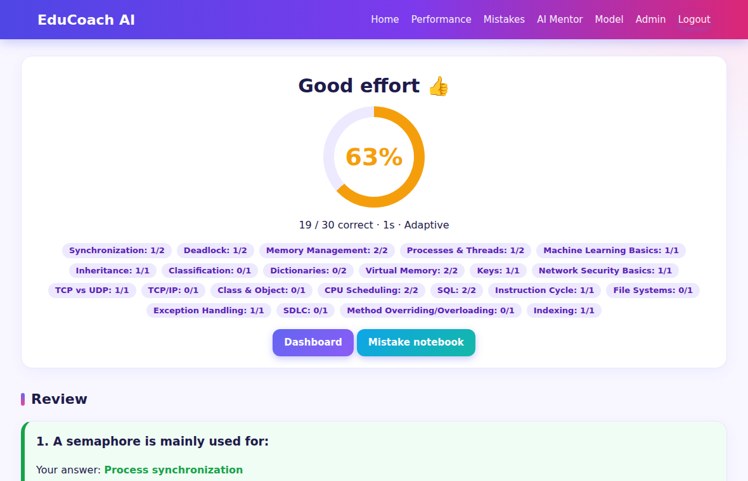
Results: application screens
Dashboard
Result page
Notes:
These are real screenshots of the app. The timings were measured with the Flask test client on one machine, so they do not include network delay.

Slide 14
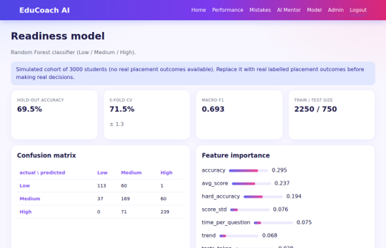
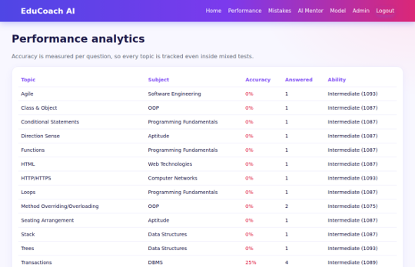
Results: application screens
Readiness Model
Performance analytics
Notes:
These are real screenshots of the app. The timings were measured with the Flask test client on one machine, so they do not include network delay.

Slide 15


Discussion
What the results show
What they do not show
Every topic gives a full 30-question test with no repeated question.
A correct hard answer raises the Elo rating more than a correct easy one, as it should.
The model scores 69.5% against a 41.3% baseline, so it learns something real.
Pages answer in a few milliseconds, so a laptop is enough.
The model was trained on simulated students, so 69.5% is not accuracy on real students.
Many technical topics still have only a few questions of their own.
The judge is not a full sandbox and only checks Python.
We have not tried the platform with a real class yet.
Notes:
I want to be honest about the limits. The left side is what we measured. The right side is what we cannot claim yet.

Slide 16
Challenges faced
1
The same question kept coming
2
The model looked too perfect
Our first bank had one question per topic copied many times. A test showed one question 30 times. We wrote generators and added curated questions.
First we trained on random data where the label was just the score. Accuracy looked great but meant nothing. We rebuilt it with noisy data.
3
Topics with too few questions
4
Forms stopped working after CSRF
Some tests came out shorter than 30. We made the selector fill from the subject and then the category.
Every form returned an error until we added the hidden token. Even logout had to become a form.
5
Choosing the Elo numbers
6
Running student code safely
Start rating 1100 and K = 20 were chosen by trying values. We have no student data to tune them yet.
An infinite loop hung the judge. We added a time limit. The memory limit works only on Linux, not on Windows.
Notes:
These are the real problems we hit while building. The first two taught us the most: a feature can look finished and still be wrong, so we added 24 automated tests.

Slide 17
Future work
1
Next
2
Later
3
Long term
Try it with a real class and collect their answers
Retrain the readiness model on real placement results
Add more questions to topics that have few
Run the judge in a container and add Java, C and C++
Add email verification and password reset
Add a teacher view for a whole class
Use a server database for many users
Add spaced repetition for the mistake notebook
Explain each readiness prediction feature by feature
Notes:
The most important next step is the first one. Until we have real students and real placement results, the readiness model is a demonstration.

Slide 18
Conclusion
Practice, adaptation, feedback and readiness estimation can share one learner profile on an ordinary laptop.
All 24 automated tests pass and every topic gives a full 30-question test.
The readiness model beats the baseline by 28 points, but it needs real student data before it can be trusted.
Thank you
Questions are welcome
Notes:
To finish: the platform works end to end, and we are clear about what still needs real data. Thank you, I am happy to take questions.

